Slide 1
Lecture 4
Agent program
Example
Environment
Properties of environment

Slide 2
Agent program
Agent program can be simple or intelligent, but the skeleton will be almost same.
They will accept signals from environment and generate actions.
Two things to note about skeleton program :
First, even though we defined the agent mapping as a function from percept sequences to actions, the agent program receives only a single percept as its input.
It is up to the agent to build up the percept sequence in memory, if it so desires.
Second, the goal or performance measure is not part of the skeleton program.
This is because the performance measure is applied externally to judge the behavior of the agent, and it is often possible to achieve high performance without explicit knowledge of the performance measure

Slide 3
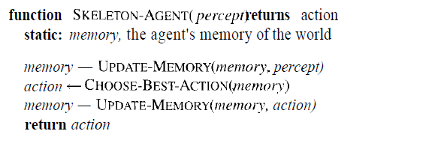
On each invocation, the agent's memory is updated to reflect the new percept, the best action is chosen, and the fact that the action was taken is also stored in memory. The memory persists from one invocation to the next.

Slide 4
Example
Let us look at the job of designing an automated taxi driver.
The full driving task is extremely open-ended—there is no limit to the novel combinations of circumstances that can arise
We must first think about the percepts, actions, goals and environment for the taxi.
See the figure in next slide.
The taxi will need to know where it is, what else is on the road, and how fast it is going.

Slide 5
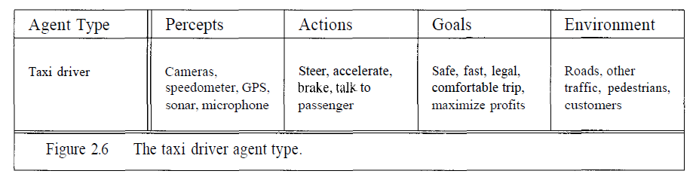

Slide 6
Based on the information given in previous slide, we have to decide how to build a real program to implement the mapping from percepts to action.
Different aspects of driving suggest different types of agent program.
Simple reflex agents
Agents that keep track of the world ( Model based reflex agent )
Goal-based agents
Utility-based agents
Learning agents

Slide 7
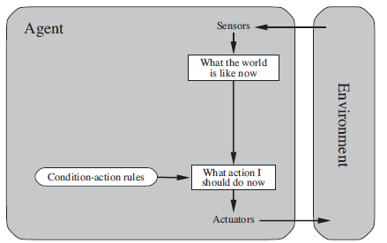
Simple reflex agents

Slide 8
The Simple reflex agents are the simplest agents. These agents take decisions on the basis of the current percepts and ignore the rest of the percept history.
These agents only succeed in the fully observable environment.
The Simple reflex agent does not consider any part of percepts history during their decision and action process.
The Simple reflex agent works on Condition-action rule, which means it maps the current state to action. Such as a Room Cleaner agent, it works only if there is dirt in the room.
Problems for the simple reflex agent design approach:
They have very limited intelligence
They do not have knowledge of non-perceptual parts of the current state
Mostly too big to generate and to store.
Not adaptive to changes in the environment.

Slide 9
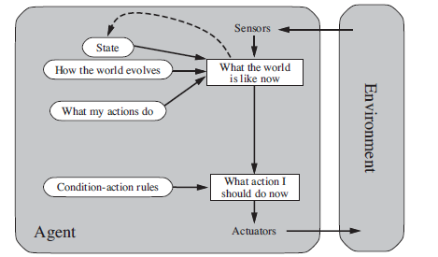
Model-based reflex agents

Slide 10
The Model-based agent can work in a partially observable environment, and track the situation.
A model-based agent has two important factors:
Model: It is knowledge about "how things happen in the world," so it is called a Model-based agent.
Internal State: It is a representation of the current state based on percept history.
These agents have the model, "which is knowledge of the world" and based on the model they perform actions.
Updating the agent state requires information about:
How the world evolves
How the agent's action affects the world.

Slide 11
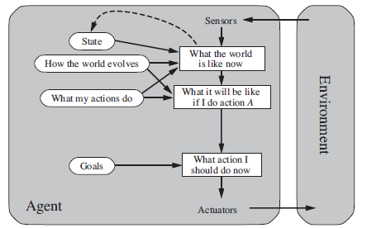
Goal based agent with explicit goal

Slide 12
The knowledge of the current state environment is not always sufficient to decide for an agent to what to do.
The agent needs to know its goal which describes desirable situations.
Goal-based agents expand the capabilities of the model-based agent by having the "goal" information.
They choose an action, so that they can achieve the goal.
These agents may have to consider a long sequence of possible actions before deciding whether the goal is achieved or not. Such considerations of different scenario are called searching and planning, which makes an agent proactive.

Slide 13
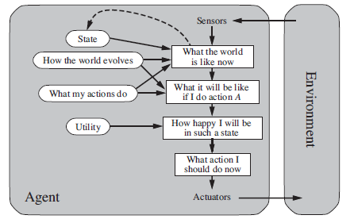
Utility based agent

Slide 14
These agents are similar to the goal-based agent but provide an extra component of utility measurement which makes them different by providing a measure of success at a given state.
Utility-based agent act based not only goals but also the best way to achieve the goal.
The Utility-based agent is useful when there are multiple possible alternatives, and an agent has to choose in order to perform the best action.
The utility function maps each state to a real number to check how efficiently each action achieves the goals.

Slide 15
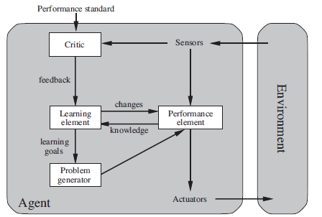
Learning Agents

Slide 16
A learning agent in AI is the type of agent which can learn from its past experiences, or it has learning capabilities.
It starts to act with basic knowledge and then able to act and adapt automatically through learning.
A learning agent has mainly four conceptual components, which are:
Learning element: It is responsible for making improvements by learning from environment
Critic: Learning element takes feedback from critic which describes that how well the agent is doing with respect to a fixed performance standard.
Performance element: It is responsible for selecting external action
Problem generator: This component is responsible for suggesting actions that will lead to new and informative experiences.

Slide 17
Properties of environment
Environments come in several flavors.
The principal distinctions to be made are as follows:
Accessible vs. inaccessible
Deterministic vs. nondeterministic.
Episodic vs. nonepisodic
Static vs. dynamic
Discrete vs. continuous

Slide 18
Accessible vs. inaccessible.
If an agent's sensory apparatus gives it access to the complete state of the environment, then we say that the environment is accessible to that agent.
An environment is effectively accessible if the sensors detect all aspects that are relevant to the choice of action.
An accessible environment is convenient because the agent need not maintain any internal state to keep track of the world. Ex. chess
Deterministic vs. nondeterministic (stochastic).
If the next state of the environment is completely determined by the current state and the actions selected by the agents, then we say the environment is deterministic. Ex. chess
In principle, an agent need not worry about uncertainty in an accessible, deterministic environment.
If the environment is inaccessible, however, then it may appear to be nondeterministic. Ex. Autonomous vehicle

Slide 19
Episodic vs. nonepisodic (sequential)
In an episodic environment, the agent's experience is divided into "episodes.“
Each episode consists of the agent perceiving and then acting.
The quality of its action depends just on the episode itself, because subsequent episodes do not depend on what actions occur in previous episodes.
Episodic environments are much simpler because the agent does not need to think ahead. Ex. Mechanical robot checking defects in a part
Static vs. dynamic
If the environment can change while an agent is deliberating, then we say the environment is dynamic for that agent; otherwise it is static.
Static environments are easy to deal with because the agent need not keep looking at the world while it is deciding on an action, nor need it worry about the passage of time.

Slide 20
Discrete vs. continuous
If there are a limited number of distinct, clearly defined percepts and actions, we say that the environment is discrete.
Chess is discrete—there are a fixed number of possible moves on each turn.
Taxi driving is continuous—the speed and location of the taxi and the other vehicles sweep through a range of continuous values.

Slide 21
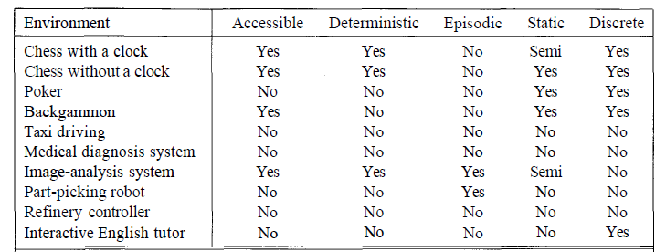
Example environments and characteristics

